Slide 1

Microsoft Power BI
Amit Bose

Slide 2
Topics
Text Table
Matrix Table
Formatting reports.
Report Themes
Adding visual-level, page-level, and report-level filters
Slicers vs Filters
Visual Interaction
Setting up drill through
Drill Down
Bookmarks in Power BI
Many to Many Relationship

Slide 3
Topics
Types of visualization in a Power BI report
Waterfall charts in Power BI
Gauge card and KPI
Funnel charts in Power BI
Tree Maps in Power BI
Maps
Custom visualization to a Power BI repost
Dial Gauge
Sunburst

Slide 4
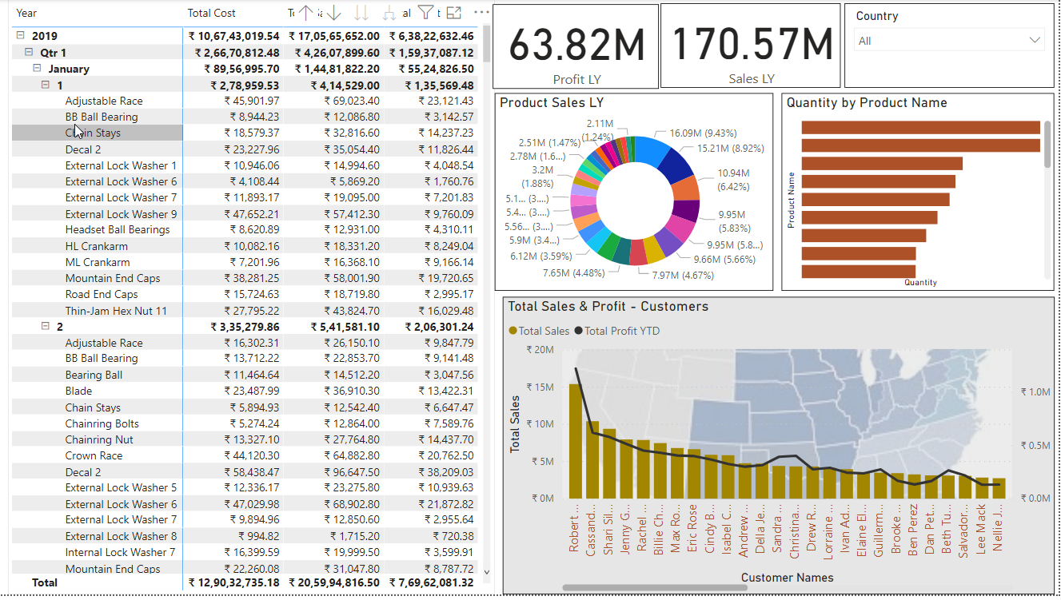
Topics

Slide 5
Water Fall Chart
A waterfall chart is a form of data visualization that helps in understanding the cumulative effect of sequentially introduced positive or negative values. These intermediate values can either be time based or category based.
What Is a Waterfall Chart?
Shows changes not only over time, but in relation to the previous period or other milestone of measurement
Each step in the waterfall gets you to the final result and demonstrates
beauty of a waterfall chart is its simplicity of construction, even in analyzing complex information

Slide 6
Gauge Chart
A gauge chart (or speedometer chart) combines a Doughnut chart and a Pie chart in a single chart.
Feature
Gauge charts are useful for comparing values between a small number of variables.
Used in executive dashboard reports to show key business indicators

Slide 7
Funnel Chart
Funnel charts are a type of chart, often used to represent stages in a sales process and show the amount of potential revenue for each stage. This type of chart can also be useful in identifying potential problem areas in an organization's sales processes.
Feature
Used to visualize the progressive reduction of data as it passes from one phase to another.
Data in each of these phases is represented as different portions of 100% (the whole).
Each stage of the funnel represents a part of the total

Slide 8
Tree Map Chart
Treemapping is a data visualization technique that is used to display hierarchical data using nested rectangles; the treemap chart is created based on this technique of data visualization.
Feature
Used for representing hierarchical data in a tree-like structure
Data, organized as branches and sub-branches, is represented using rectangles, the dimensions and plot colors of which are calculated
You can drill down within the data to, theoretically, an unlimited number of levels.

Slide 9
Power BI Maps
Power BI integrates with Bing to provide default map coordinates (a process called geo-coding). When you create a map visualization in Power BI service or Power BI Desktop, the data in the Location, Latitude, and Longitude buckets (that is being used to create that visualization) is sent to Bing.
Map Types
Bubble Map – Highlighting areas with bubbles
Filled Map – Covering a specific area.
ArcGIS Map - Spatial analysis leads to greater understanding by mapping relevant locations and spotting relationships and patterns—ultimately helping you determine the best actions to take.

Slide 10
Thank You
Happy Learning

